Slide 1

AAP 2: Setting Student Improvement Targets
November 14 – 18, 2019

Slide 2

Rigorous but Achievable Targets
To meet the goals of the Cleveland Plan, we have set school and district targets that are rigorous but achievable.
To achieve these aggregate targets, we need to similarly identify rigorous but achievable targets for students that will move school and district measures.

Slide 3
Rigorous but Achievable Targets
Some of our assessments provide guidance on the expected amount of growth, but we need to think about whether these targets are rigorous enough.
  What is the assessment’s growth expectation?
  What is the state’s growth expectation?

Slide 4
Rigorous but Achievable Targets
Ohio Report Card measures grounded in OSTs and the idea of a performance level.
Ohio’s growth measure based on keeping pace with the rest of the state of Ohio.
NWEA growth expectations based on the average improvement historically shown by other students in the same grade, subject and term with the same starting score.

Slide 5
Mapping Growth Expectations and Performance Levels
Will students consistently meeting NWEA growth norms show improvements on OSTs?
How long does it take for students meeting NWEA growth norms to improve a level?

Slide 6
Mapping Growth Expectations and Performance Levels
Table 1: RIT score trajectory in reading for a student meeting NWEA MAP growth norms
Grade | Term | RIT Score | Expected Growth | Predicted Performance Level | Basic Cut Score | Gap to Basic | Proficient Cut Score | Gap to Proficient
3rd | Spring | 170 | --
4th | Spring | 180 | 10
5th | Spring | 189 | 9
6th | Spring | 195 | 6
7th | Spring | 201 | 6
8th | Spring | 206 | 5
Table 2: NWEA MAP cut scores corresponding to Ohio’s state scores when MAP is taken in spring, ELA / Reading
Grade | Limited RIT Range | Basic RIT Range | Proficient RIT Range | Accelerated RIT Range | Advanced RIT Range
3rd | 100 – 190 | 191 – 198 | 199 – 205 | 206 – 211 | 212 – 350
4th | 100 – 196 | 197 – 205 | 206 – 213 | 214 – 220 | 221 – 350
5th | 100 – 200 | 201 – 209 | 210 – 216 | 217 – 223 | 224 – 350
6th | 100 – 205 | 206 – 216 | 217 – 223 | 224 – 231 | 232 – 350
7th | 100 – 207 | 208 – 219 | 220 – 227 | 228 – 235 | 236 – 350
8th | 100 – 217 | 218 – 225 | 226 – 235 | 236 – 242 | 243 – 350
Notes:
Average 3rd grade RIT score in 2018-2019 school year was 177.

Slide 7
Mapping Growth Expectations and Performance Levels
Table 1: RIT score trajectory in reading for a student meeting NWEA MAP growth norms
Grade | Term | RIT Score | Expected Growth | Predicted Performance Level | Basic Cut Score | Gap to Basic | Proficient Cut Score | Gap to Proficient
3rd | Spring | 170 | -- | Limited
4th | Spring | 180 | 10
5th | Spring | 189 | 9
6th | Spring | 195 | 6
7th | Spring | 201 | 6
8th | Spring | 206 | 5
Table 2: NWEA MAP cut scores corresponding to Ohio’s state scores when MAP is taken in spring, ELA / Reading
Grade | Limited RIT Range | Basic RIT Range | Proficient RIT Range | Accelerated RIT Range | Advanced RIT Range
3rd | 100 – 190 | 191 – 198 | 199 – 205 | 206 – 211 | 212 – 350
4th | 100 – 196 | 197 – 205 | 206 – 213 | 214 – 220 | 221 – 350
5th | 100 – 200 | 201 – 209 | 210 – 216 | 217 – 223 | 224 – 350
6th | 100 – 205 | 206 – 216 | 217 – 223 | 224 – 231 | 232 – 350
7th | 100 – 207 | 208 – 219 | 220 – 227 | 228 – 235 | 236 – 350
8th | 100 – 217 | 218 – 225 | 226 – 235 | 236 – 242 | 243 – 350
Notes:
Average 3rd grade RIT score in 2018-2019 school year was 177.

Slide 8
Mapping Growth Expectations and Performance Levels
Table 1: RIT score trajectory in reading for a student meeting NWEA MAP growth norms
Grade | Term | RIT Score | Expected Growth | Predicted Performance Level | Basic Cut Score | Gap to Basic | Proficient Cut Score | Gap to Proficient
3rd | Spring | 170 | -- | Limited | 191
4th | Spring | 180 | 10
5th | Spring | 189 | 9
6th | Spring | 195 | 6
7th | Spring | 201 | 6
8th | Spring | 206 | 5
Table 2: NWEA MAP cut scores corresponding to Ohio’s state scores when MAP is taken in spring, ELA / Reading
Grade | Limited RIT Range | Basic RIT Range | Proficient RIT Range | Accelerated RIT Range | Advanced RIT Range
3rd | 100 – 190 | 191 – 198 | 199 – 205 | 206 – 211 | 212 – 350
4th | 100 – 196 | 197 – 205 | 206 – 213 | 214 – 220 | 221 – 350
5th | 100 – 200 | 201 – 209 | 210 – 216 | 217 – 223 | 224 – 350
6th | 100 – 205 | 206 – 216 | 217 – 223 | 224 – 231 | 232 – 350
7th | 100 – 207 | 208 – 219 | 220 – 227 | 228 – 235 | 236 – 350
8th | 100 – 217 | 218 – 225 | 226 – 235 | 236 – 242 | 243 – 350
Notes:
Average 3rd grade RIT score in 2018-2019 school year was 177.

Slide 9
Mapping Growth Expectations and Performance Levels
Table 1: RIT score trajectory in reading for a student meeting NWEA MAP growth norms
Grade | Term | RIT Score | Expected Growth | Predicted Performance Level | Basic Cut Score | Gap to Basic | Proficient Cut Score | Gap to Proficient
3rd | Spring | 170 | -- | Limited | 191 |  | 199
4th | Spring | 180 | 10
5th | Spring | 189 | 9
6th | Spring | 195 | 6
7th | Spring | 201 | 6
8th | Spring | 206 | 5
Table 2: NWEA MAP cut scores corresponding to Ohio’s state scores when MAP is taken in spring, ELA / Reading
Grade | Limited RIT Range | Basic RIT Range | Proficient RIT Range | Accelerated RIT Range | Advanced RIT Range
3rd | 100 – 190 | 191 – 198 | 199 – 205 | 206 – 211 | 212 – 350
4th | 100 – 196 | 197 – 205 | 206 – 213 | 214 – 220 | 221 – 350
5th | 100 – 200 | 201 – 209 | 210 – 216 | 217 – 223 | 224 – 350
6th | 100 – 205 | 206 – 216 | 217 – 223 | 224 – 231 | 232 – 350
7th | 100 – 207 | 208 – 219 | 220 – 227 | 228 – 235 | 236 – 350
8th | 100 – 217 | 218 – 225 | 226 – 235 | 236 – 242 | 243 – 350
Notes:
Average 3rd grade RIT score in 2018-2019 school year was 177.

Slide 10
Mapping Growth Expectations and Performance Levels
Table 1: RIT score trajectory in reading for a student meeting NWEA MAP growth norms
Grade | Term | RIT Score | Expected Growth | Predicted Performance Level | Basic Cut Score | Gap to Basic | Proficient Cut Score | Gap to Proficient
3rd | Spring | 170 | -- | Limited | 191 | 191-170 | 199 | 199-170
4th | Spring | 180 | 10
5th | Spring | 189 | 9
6th | Spring | 195 | 6
7th | Spring | 201 | 6
8th | Spring | 206 | 5
Table 2: NWEA MAP cut scores corresponding to Ohio’s state scores when MAP is taken in spring, ELA / Reading
Grade | Limited RIT Range | Basic RIT Range | Proficient RIT Range | Accelerated RIT Range | Advanced RIT Range
3rd | 100 – 190 | 191 – 198 | 199 – 205 | 206 – 211 | 212 – 350
4th | 100 – 196 | 197 – 205 | 206 – 213 | 214 – 220 | 221 – 350
5th | 100 – 200 | 201 – 209 | 210 – 216 | 217 – 223 | 224 – 350
6th | 100 – 205 | 206 – 216 | 217 – 223 | 224 – 231 | 232 – 350
7th | 100 – 207 | 208 – 219 | 220 – 227 | 228 – 235 | 236 – 350
8th | 100 – 217 | 218 – 225 | 226 – 235 | 236 – 242 | 243 – 350
Notes:
Average 3rd grade RIT score in 2018-2019 school year was 177.

Slide 11
Mapping Growth Expectations and Performance Levels
Table 1: RIT score trajectory in reading for a student meeting NWEA MAP growth norms
Grade | Term | RIT Score | Expected Growth | Predicted Performance Level | Basic Cut Score | Gap to Basic | Proficient Cut Score | Gap to Proficient
3rd | Spring | 170 | -- | Limited | 191 | 21 | 199 | 29
4th | Spring | 180 | 10
5th | Spring | 189 | 9
6th | Spring | 195 | 6
7th | Spring | 201 | 6
8th | Spring | 206 | 5
Table 2: NWEA MAP cut scores corresponding to Ohio’s state scores when MAP is taken in spring, ELA / Reading
Grade | Limited RIT Range | Basic RIT Range | Proficient RIT Range | Accelerated RIT Range | Advanced RIT Range
3rd | 100 – 190 | 191 – 198 | 199 – 205 | 206 – 211 | 212 – 350
4th | 100 – 196 | 197 – 205 | 206 – 213 | 214 – 220 | 221 – 350
5th | 100 – 200 | 201 – 209 | 210 – 216 | 217 – 223 | 224 – 350
6th | 100 – 205 | 206 – 216 | 217 – 223 | 224 – 231 | 232 – 350
7th | 100 – 207 | 208 – 219 | 220 – 227 | 228 – 235 | 236 – 350
8th | 100 – 217 | 218 – 225 | 226 – 235 | 236 – 242 | 243 – 350
Notes:
Average 3rd grade RIT score in 2018-2019 school year was 177.

Slide 12
Mapping Growth Expectations and Performance Levels
Working as a school team, investigate the relationship between NWEA growth norms and OST performance levels.
Answer the questions in the handout. Be ready to share your answers and thoughts.

Slide 13
Mapping Growth Expectations and Performance Levels
Table 1: RIT score trajectory in reading for a student meeting NWEA MAP growth norms
Grade | Term | RIT Score | Expected Growth | Predicted Performance Level | Basic Cut Score | Gap to Basic | Proficient Cut Score | Gap to Proficient
3rd | Spring | 170 | -- | Limited | 191 | 21 | 199 | 29
4th | Spring | 180 | 10 | Limited | 197 | 17 | 206 | 26
5th | Spring | 189 | 9 | Limited | 201 | 12 | 210 | 21
6th | Spring | 195 | 6 | Limited | 206 | 11 | 217 | 22
7th | Spring | 201 | 6 | Limited | 208 | 7 | 220 | 19
8th | Spring | 206 | 5 | Limited | 218 | 12 | 226 | 20
Rate of gap change per year
 | Gap to Basic Change | Gap to Proficient Change
3rd to 4th | 4 | 3
4th to 5th | 5 | 5
5th to 6th | 1 | -1
6th to 7th | 4 | 3
7th to 8th | -5 | -1
AVERAGE | 1.8 | 1.8
 | 12 / 1.8 = 6.66 years to Basic | 20 / 1.8 = 11.11 years to Proficient

Slide 14
Setting Targets for this School Year
NWEA’s growth norms are not rigorous enough for our district to achieve its goals in a timely fashion.
More rigorous targets are needed, and are also achievable, based on our own historical data.

Slide 15
Setting Targets for this School Year
For students that grew Fall to Spring on NWEA in the 2018-2019 SY:
  Average growth in Reading was 9.9 and average growth expectation in Reading was 7.1
  Average growth in Mathematics was 10.7 and average growth expectation in Mathematics was 8.7
Need to keep up this pace and stop the student backsliding.

Slide 16
Setting Targets for this School Year
Use the data we have provided to all schools to set rigorous targets for students.
Consider student context, but work to set goals that will move students a performance level.
Consider how student level goals will help the building achieve overall goals.

Slide 17
Setting Targets for this School Year
NWEA Fall Performance Index Calculations
Proficiency Level | Number of Tests | Total Tests | Percent of Tests | Weighted Points
Advanced | 60 | 592 | 10.14 | 12.168
Accelerated | 111 | 592 | 18.75 | 20.625
Proficient | 159 | 592 | 26.86 | 26.86
Basic | 115 | 592 | 19.43 | 11.658
Limited | 147 | 592 | 24.83 | 7.449
 |  |  | Total Points | 78.76
 |  |  | Performance Index Percent | 65.63
Performance Index End of Year Goal Calculations
Proficiency Level | Percent of Tests | Weighted Points
Advanced | 9.85 | 11.82
Accelerated | 19.13 | 21.043
Proficient | 38.64 | 38.64
Basic | 20.08 | 12.048
Limited | 12.31 | 3.693
 | Total Points | 87.244
 | Performance Index Percent | 72.7

Slide 18
Setting Targets for this School Year
First Name | Last Name | grade | OST 2019 Performance Level | OST 2019 Scaled Score | NWEA Fall Performance Level | NWEA Fall RIT Score | NWEA Fall Percentile | Performance Level Movement
 |  | 04 | Accelerated | 725 | Proficient | 200 | 55 | Declined 1 Level
 |  | 04 | Accelerated | 725 | Proficient | 200 | 55 | Declined 1 Level
 |  | 04 | Basic | 682 | Limited | 184 | 18 | Declined 1 Level
 |  | 04 | Basic | 682 | Limited | 184 | 18 | Declined 1 Level
 |  | 04 | Basic | 693 | Limited | 182 | 15 | Declined 1 Level
 |  | 04 | Basic | 693 | Limited | 182 | 15 | Declined 1 Level
 |  | 04 | Basic | 687 | Limited | 164 | 1 | Declined 1 Level
 |  | 04 | Basic | 687 | Limited | 164 | 1 | Declined 1 Level
 |  | 04 | Proficient | 700 | Basic | 196 | 44 | Declined 1 Level
 |  | 04 | Proficient | 703 | Basic | 194 | 39 | Declined 1 Level
 |  | 04 | Accelerated | 738 | Proficient | 206 | 69 | Declined 1 Level
 |  | 04 | Accelerated | 738 | Proficient | 206 | 69 | Declined 1 Level
 |  | 04 | Accelerated | 744 | Proficient | 205 | 67 | Declined 1 Level
 |  | 04 | Proficient | 708 | Basic | 194 | 39 | Declined 1 Level
 |  | 04 | Advanced | 755 | Accelerated | 214 | 85 | Declined 1 Level
 |  | 04 | Advanced | 755 | Accelerated | 214 | 85 | Declined 1 Level
 |  | 04 | Accelerated | 744 | Proficient | 207 | 72 | Declined 1 Level
 |  | 04 | Accelerated | 733 | Proficient | 204 | 65 | Declined 1 Level
 |  | 04 | Accelerated | 733 | Limited | 173 | 5 | Declined 3 Levels

Slide 19
AAP 2: Complex Academic Tasks
November 14 – 18, 2019

Slide 20

High Quality Differentiated Instruction:
High quality instruction is the result of a strong implementation of the instructional core.
Notes:
1 minute: High quality instruction is a strong implementation of the instructional core. Walk participants quickly through the instructional core using the graphic.

Slide 21
High Quality Differentiated Instruction:
It is a personalized, challenging, rigorous and standards aligned curriculum.
Teachers provide students with opportunities to make good choices in how they learn, probe students with questions that increase in cognitive complexity and provide feedback to students that is timely, actionable and specific.
Students engage in cooperative learning, make connections and make appropriate choices for their learning so that they can demonstrate mastery on complex academic tasks in a variety of ways
Notes:
1 minute: This is CMSD’s definition of high quality differentiated instruction. We want to move to a place where we all share this same definition and have a common understanding of what each bullet looks and sounds like in our schools.

Slide 22
High Quality Differentiated Instruction:
Complex Academic Tasks
Gradual Release
Student Engagement and Agency (voice and choice)
Notes:
1 minute: This is the Reader’s Digest version of our definition of high quality differentiated instruction. We are really looking for these three things. Our district has been using the term “Complex Academic Tasks” regularly this year. As an example, CEO Gordon referenced several examples of where this is happening in his State of the Schools Address. Today, we are going to dive a little deeper into complex academic tasks to begin socializing what we mean when we say this.

Slide 23
September Homework Assignment:
How will you introduce one of the following big ideas to your staff?
  Learning in our schools is engaging, rigorous, challenging and fun.
  All students deserve an excellent education and equity of access and service.
  Our students must be presented with complex academic tasks in order to develop the Attributes of a CMSD Graduate.
Notes:
1 minute: Remind participants of the homework assignment from September. Connect this to today’s session.

Slide 24
Complex Academic Tasks
“If we want students to develop the capacity to think, reason, and problem solve, then we need to start with high-level, cognitively complex tasks.” - Stein and Lane 1996
Notes:
1 minute: This is why we are starting here. We knew the importance of complex academic tasks way back in 1996. In order to get the attributes of a CMSD Graduate – we have to get them to think through complex tasks.

Slide 25
Complex Academic Tasks:
Are aligned to grade-level standards
Promote reasoning, problem solving, and present a real-world connection
Require higher order thinking skills (Bloom’s Taxonomy of Learning)
Require strategic thinking (short or long term- Webb Depth Of Knowledge)
In many cases, involve complex texts that expand students’ academic language
Lead to productive student struggle
Notes:
1 minute: Review definition with participants.

Slide 26
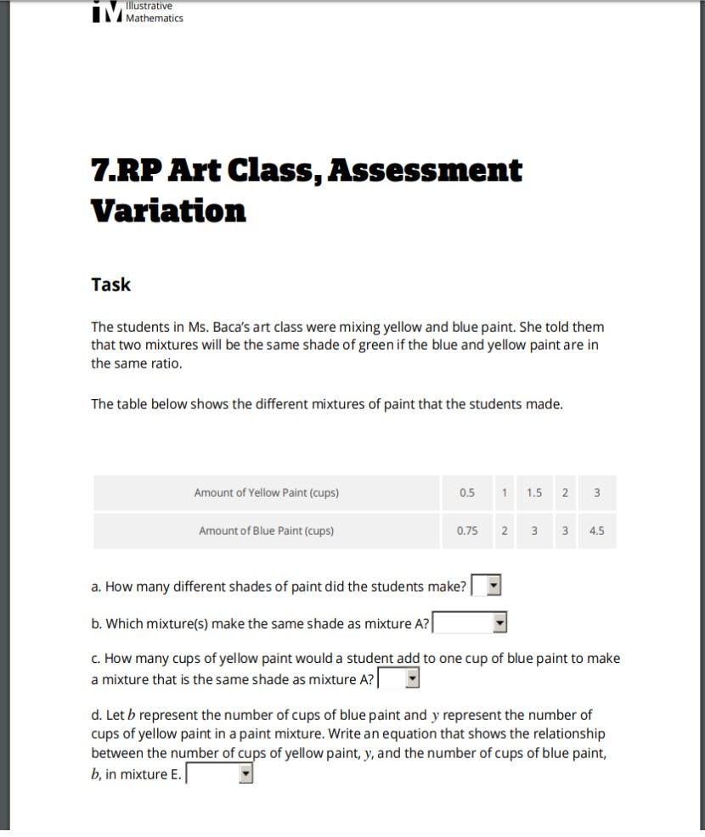
Let’s Examine a Complex Task

Slide 27
Discuss With Your Team:
How does this task fit the definition of a Complex Academic Task?
  Aligned to grade level standard – person 1
  Promote reasoning, problem solving, and present a real-world connection – person 2
  Require higher order thinking skills (Bloom’s) – person 3
  Require strategic thinking (DOK) – person 4
  Lead to productive student struggle - ALL
Notes:
10 minutes: First, ask participants to spend some time solving the problem. Next, have each person on the school’s team look for one of the above requirements. Do share out after giving them a few minutes to discuss with team.
Standard: 7.RP.A.2
Blooms: Analysis – students are analyzing ratios to make comparisons of the different shades of paint
DOK: Level 3 – students are interpreting information from a table in order to identify and justify their solution
Students must reason by comparing the different ratios from mixing the blue and yellow paint; problem solving occurs when students must apply new information to the given problem numbers; the real world connection is presented through solving rations by thinking about mixing paint colors in an art class

Slide 28
School Team Reflection
Has your monitoring of this year’s AAP given you insight into how often students are being exposed to Complex Academic Tasks this year?
What do the teachers in your building need to learn about Complex Academic Tasks?
How can you begin to support your teachers with their understanding of Complex Academic Tasks?
Notes:
5 minutes

Slide 29

AAP Feedback Session: Tuning Protocol
Please transition to your AAP Feedback Session room
All feedback should center around the focus question: Is the presenter effectively monitoring the strategies identified within their AAP in a way that is likely to lead to improved student outcomes? How do you know?
Notes:
Quick reminder to participants to focus their feedback on monitoring.

